Slide 1



Slide 2
1. PROJECT PRESENTATION PREPUD / FDA
2. PROJECT PRESENTATION PREPUD / ABD
3. PROJECT PRESENTATION PREPUB / IDB
4. PROJECT PRESENTATION PREPUD / IDA
5. PRESENTATION OF ACTIVITIES CARRIED BY SDD
6. PRESENTATION OF ACTIVITIES CARRIED OUT BY THE MFD
7. PRESENTATION OF ACTIVITIES CARRIED BY RED

Slide 3



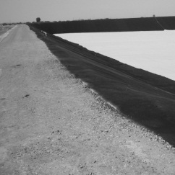

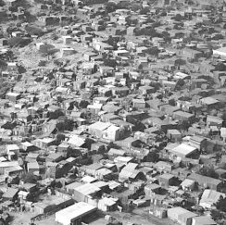

Républic of Djibouti
Ministry of the Interior
State Secretary for National Solidarity
Solid waste management project
Situation of the project on the 1st of october 2014
Groupement

Slide 4
Project Description
    FRAMEWORK OF THE ACTION
Project duration: 3 years (2014-2016)
Total budget: 6.2 million euros
Reduction of urban poverty
    EXPECTED RESULTS
Availability of grouping points for the collection of waste
Rehabilitation of the equipment Park at quartier7 and construction of an equipment park at Balbala
Partnership with committed informal sector;
Institutional and operational optimization of the recommendations for the implemented OVD;
Strengthening plan of the implemented OVD
Improvements of sorting and recycling with job creation;
Availability of a branch for building material from plastic waste.
    GENERAL OBJECTIVES
Improvement of the living conditions of the local population and reduction of extreme and relative poverty
    SPECIFIC OBJECTIVES
logical management of solid waste;
Creating formal and permanent jobs in the area of solid waste management.

Slide 5
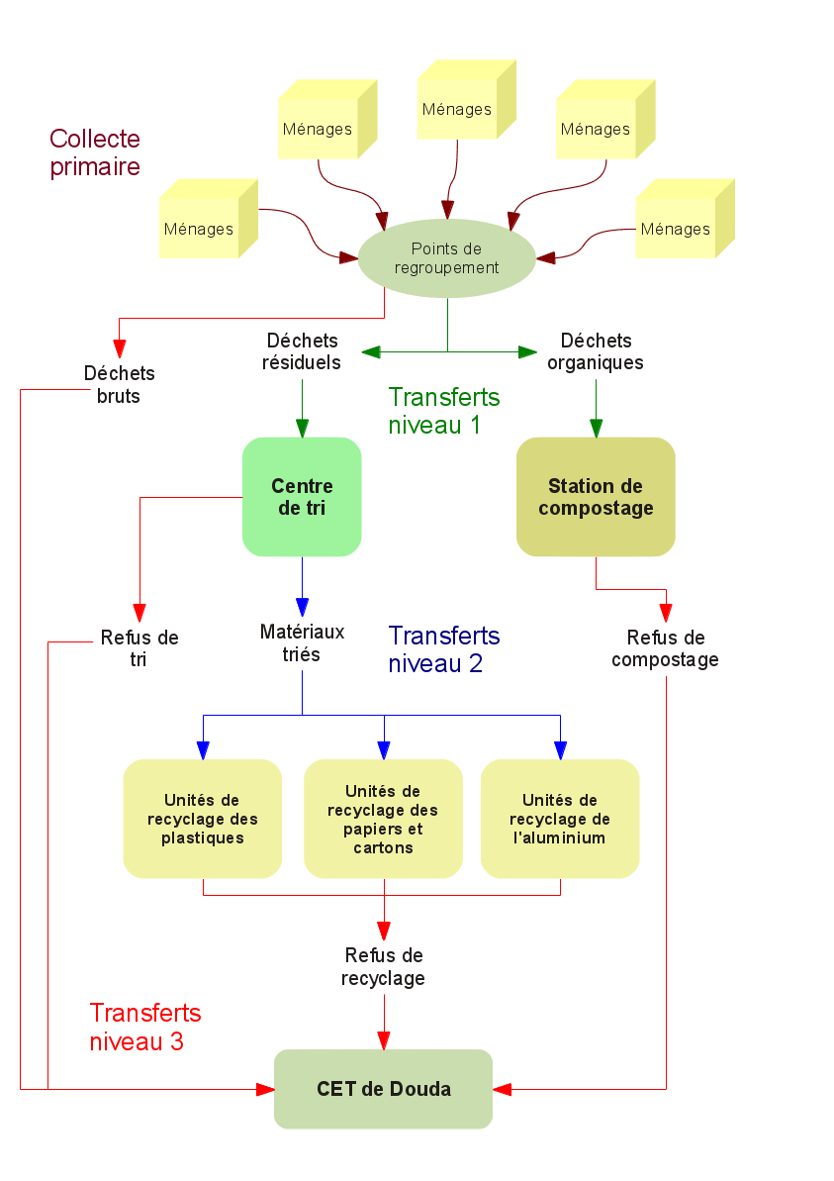
Modus operandi

Slide 6
Component 1 : Gathering point

Slide 7

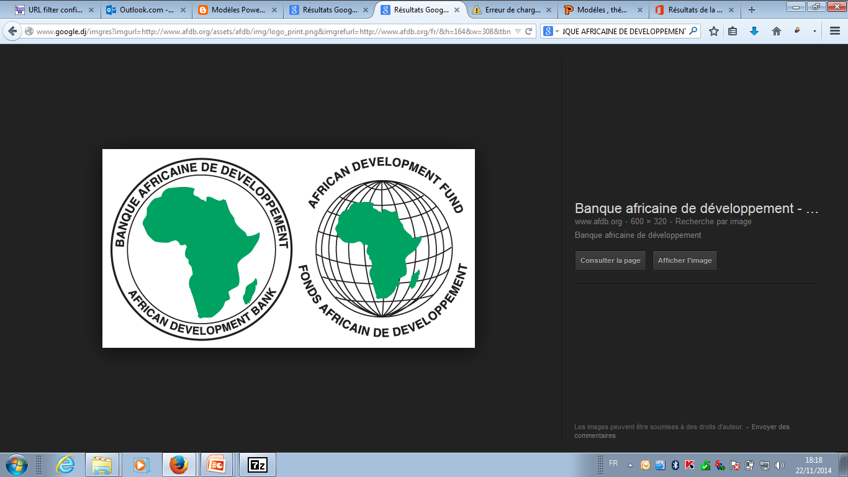
SUPPORT FOR A PROGRAM OF URBAN POVERTY REDUCTION
(ALI-SABIEH, ARTA, Dikhil OBOCK, Tadjourah)

Slide 8
PROJECT DESCRIPTION
Initial FDA grant : 9.432 millions USD
Additional FDA grant : 1.296 million USD
Government Contribution : 3.144 million USD
Date of approval : 17/10/2008
Date of effect : 13/11/2008
Initial donation amount disbursed : 4.580 USD (50 %)
Additional donation amount disbursed : 961 935 USD
Initial donation Deadline cashing : 30 juin 2015
Additional donation Deadline Cashing : 30 juin 2015
Requests for extensions : submitted to BAD

Slide 9
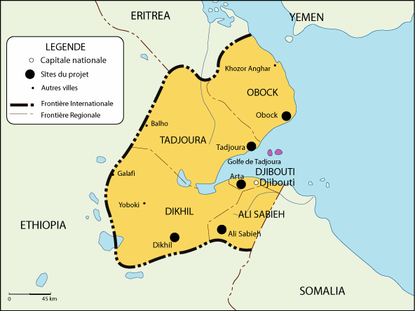
INTERVENTION AREA

Slide 10
INTERVENTION AXIS
Strengthening of capacity
Improving access to basic infrastructure
Project Management

Slide 11
I. Strenghtening of capacities
ACHIEVEMENTS OVER THE INITIAL GRANT
Institutional support for governance (national level) | S.N.D.U. training managers DHU AT Secretariat of State for Housing
2. Institutional support at the governance (regional) | S.D.A.U. AT Interior Ministry Training (elected officials, stone cutting, study trips) Support to regional councils (equipment and computer network , Internet, web portal)
3. Community Development Support | Community Development Fund
4. Promotion of microfinance | Training (technical teams, elected workers)

Slide 12
II. INFRASTRUCTURES
Regions | Type of infrastructure
OBOCK | Meat market Rehabilitation
TADJOURAH | Rehabilitation of the meat market and stalls
ALI-SABIEH | Construction of a bus station
 | Public market Rehabilitation
DIKHIL | Construction of a craft showcase and playground
 | Rehabilitation and reorganization of existing public market
ARTA | construction of a craft showcase
 | Construction of a bus station
 | Construction of the access road to the market

Slide 13
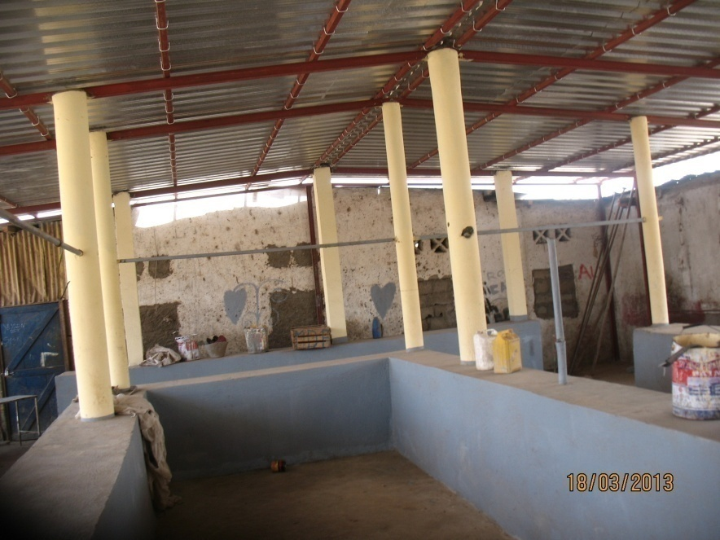
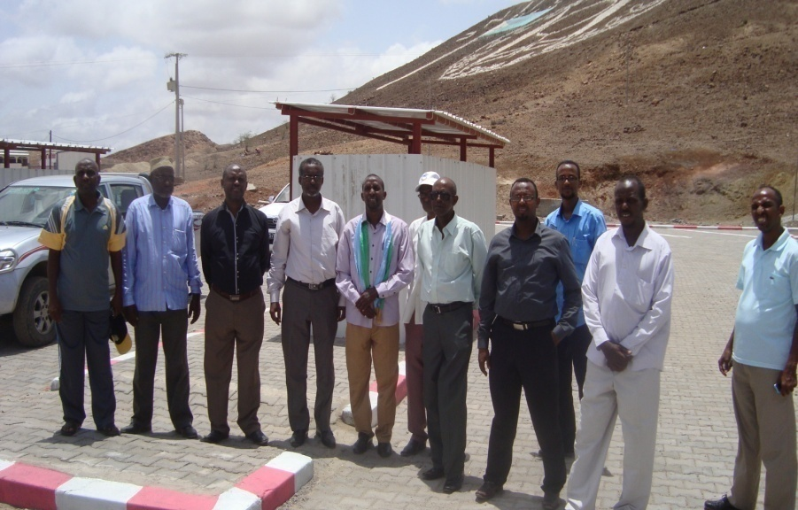
Pictures of infrastructure works

Slide 14
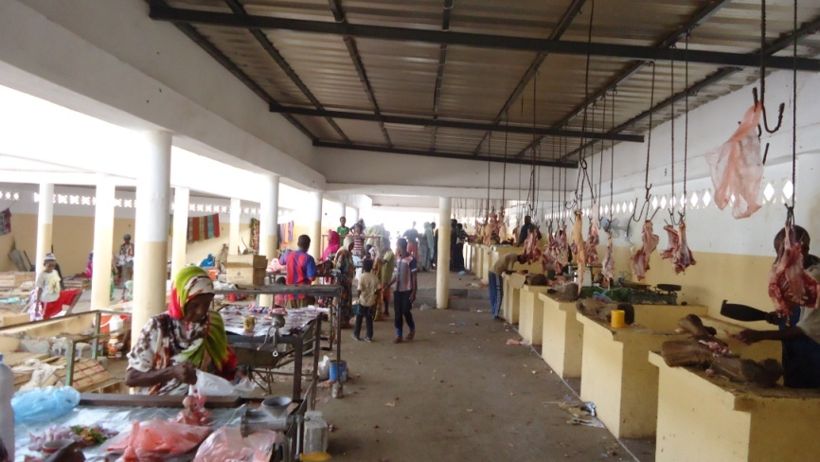
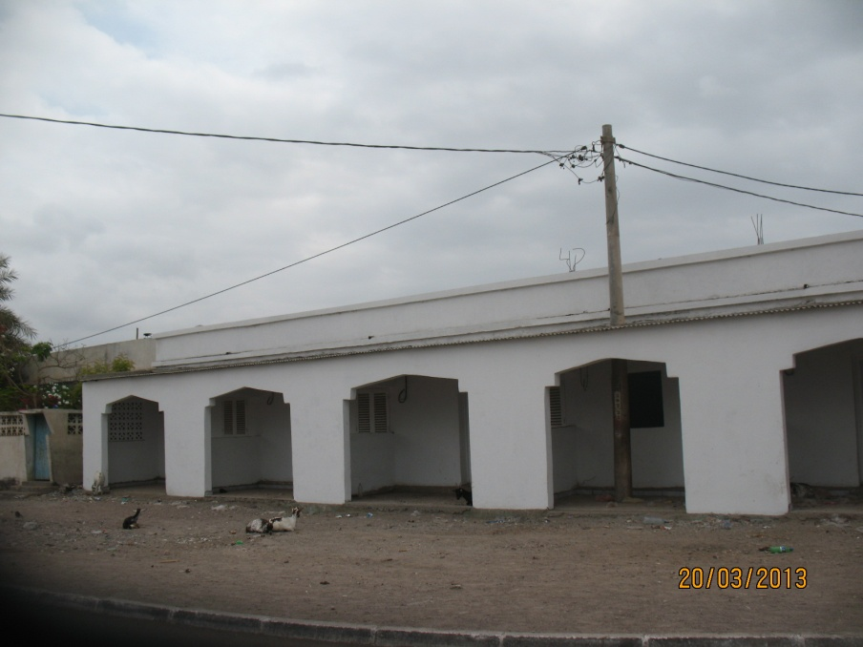
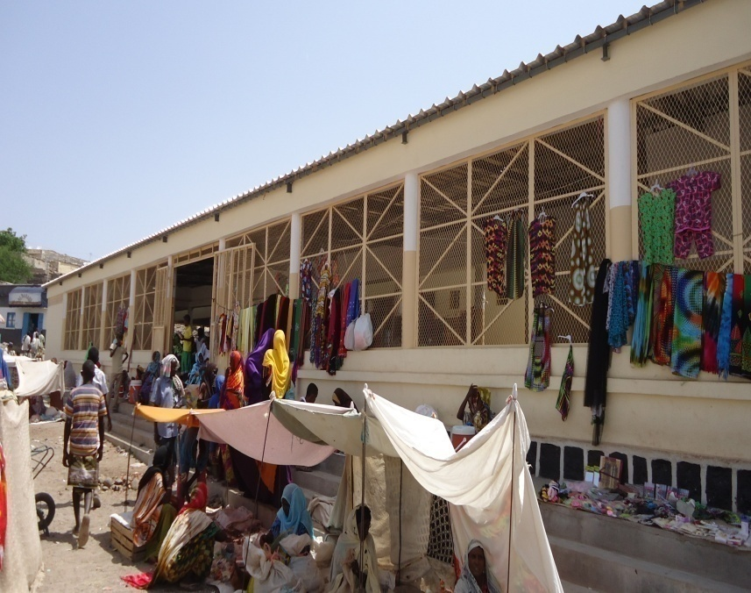
Pictures of infrastructure works

Slide 15
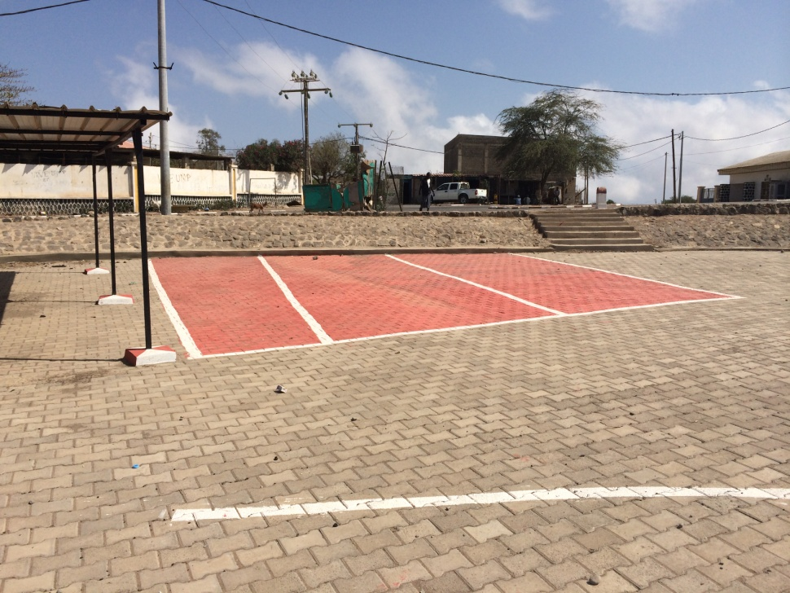
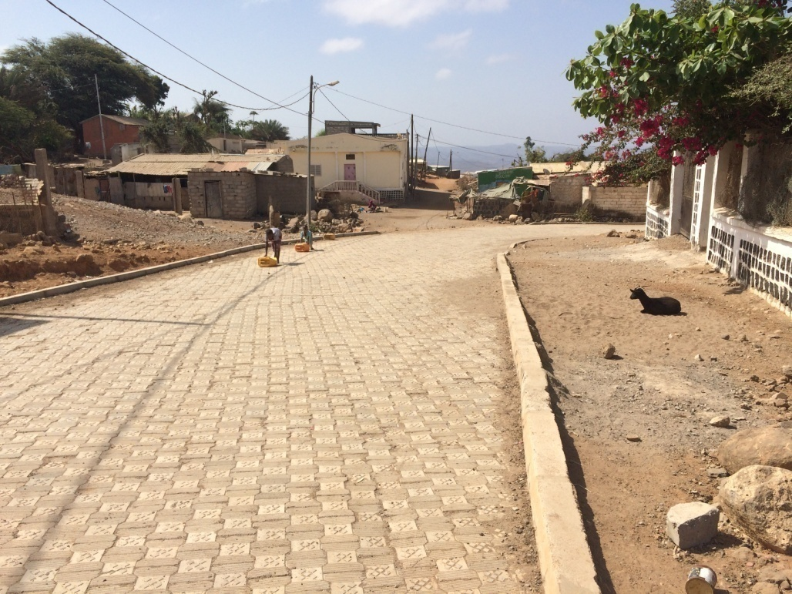
Pictures of infrastructure works

Slide 16
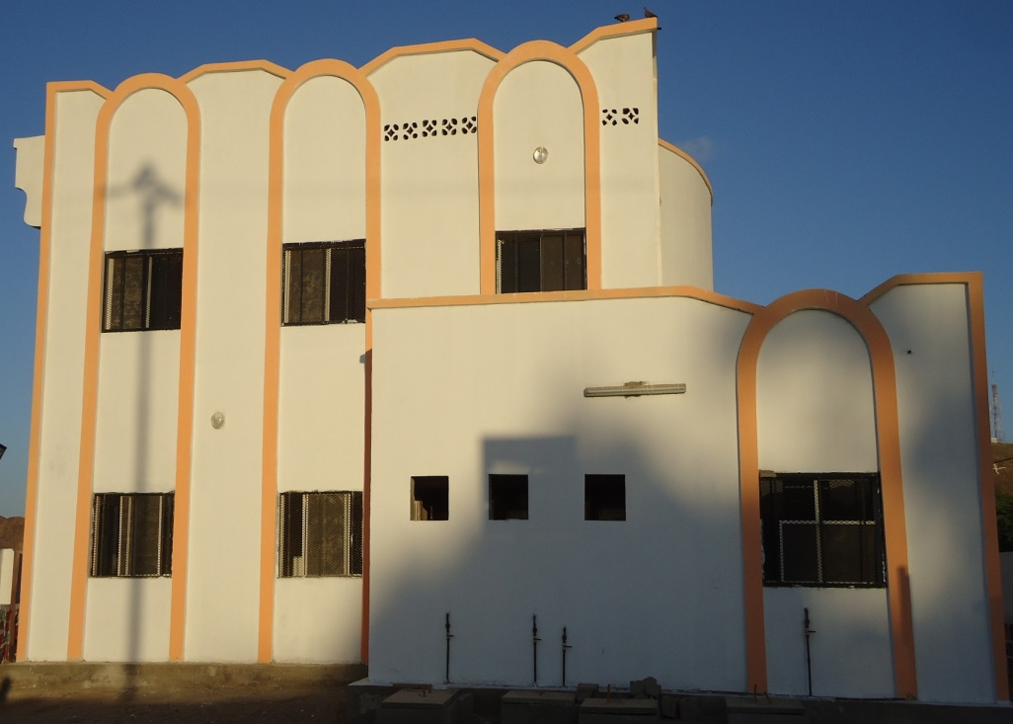
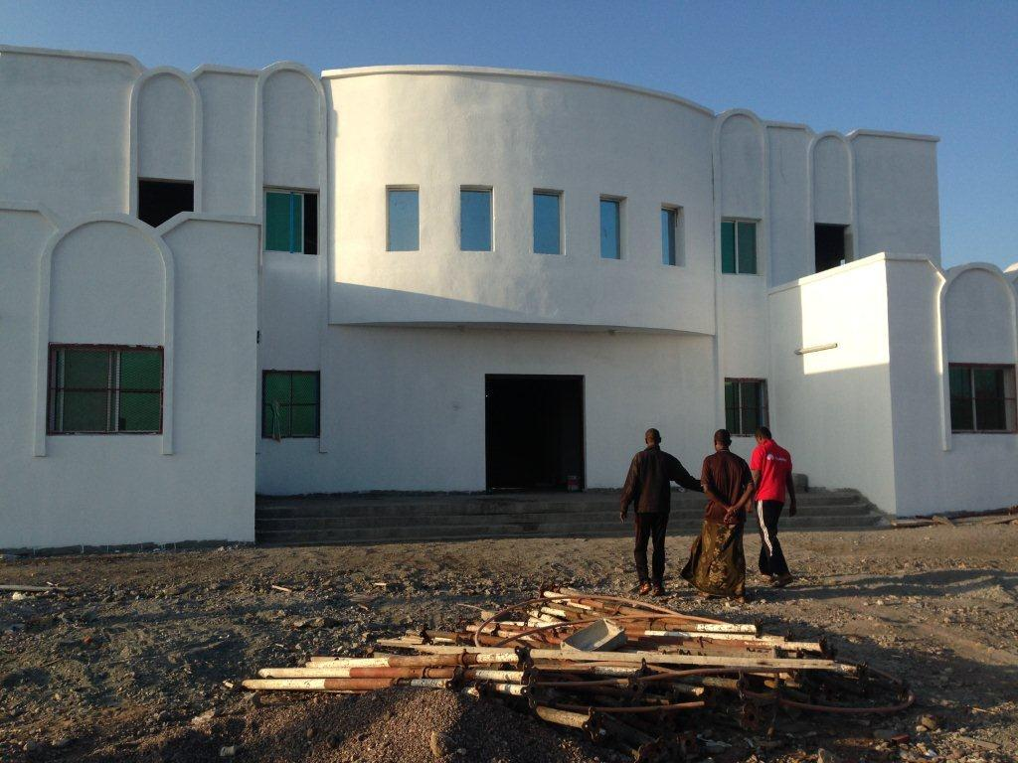
Pictures of infrastructure works

Slide 17
ACHIEVEMENTS ON ADDITIONAL DONATION
Infrastructures/Activities | Characteristics
INFRASTRUCTURE
Allocation of work markets of cattle park (Dikhil) | 15 000 square meters
Training room at UD | 1
CAPACITIES STRENGHTENING (DISED)
Training | Training of statisticians
Investigation | EDAM BC

Slide 18
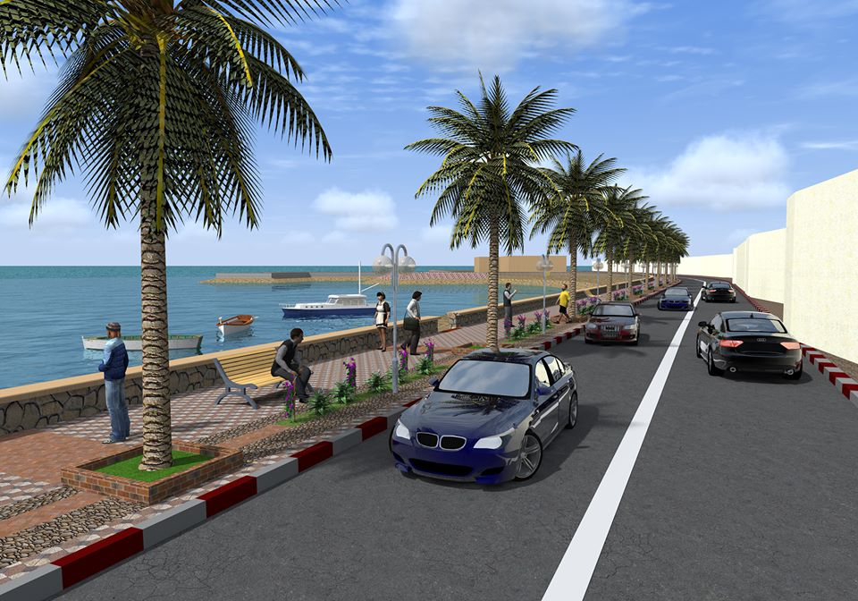
CORNICHE OF TADJOURAH

Slide 19
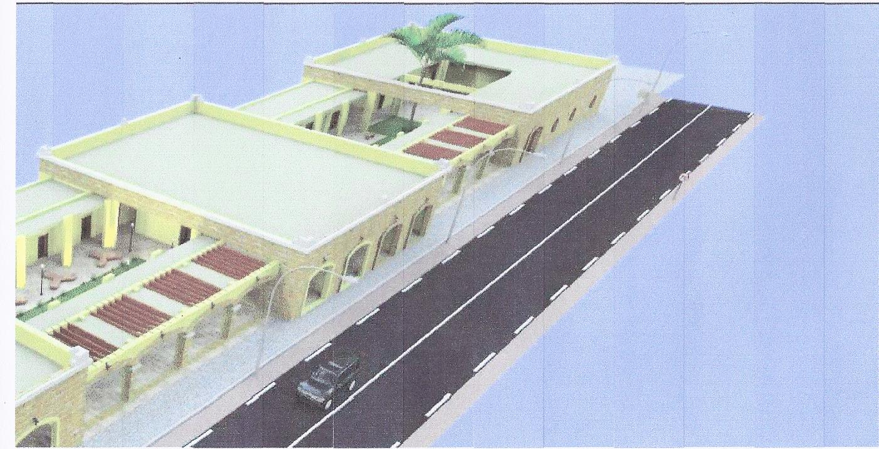
COMMERCIAL BLOCK AND ACCESS ROAD TO OBOCK

Slide 20
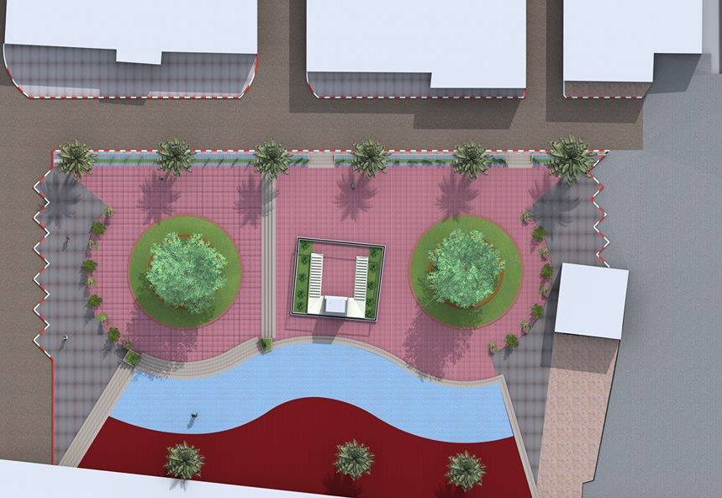
DEVELOPMENT OF A PLAZA IN DIKHIL

Slide 21
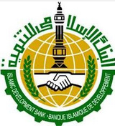
URBAN POVERTY REDUCTION PROGRAM IN Balbala(Q. BAHACHE, OLD BALBALA, QARAWIL, CHEIK MOUSSA, Q. 5)

Slide 22
Projet description
Loan: 8,5 Millions USD
Grant : 0,25 Millions USD
Loan agreements N°3-0058 DI / Don N° 3-0059 DI
Government contribution : 5,75 Millions USD
Beginning : 2009
expected end : Décembre 2015

Slide 23
TRAINING CENTER FOR EMPLOYMENT AND COMPANIES OF BALBALA
Unit size : 10508 m²
Covered area of central buildings firm piece+ optional piece : 2955,5 m²
Built area : 1519,47 m²
Starting date : février 2013
Expected Completion Date : février 2014
N°1 Project

Slide 24
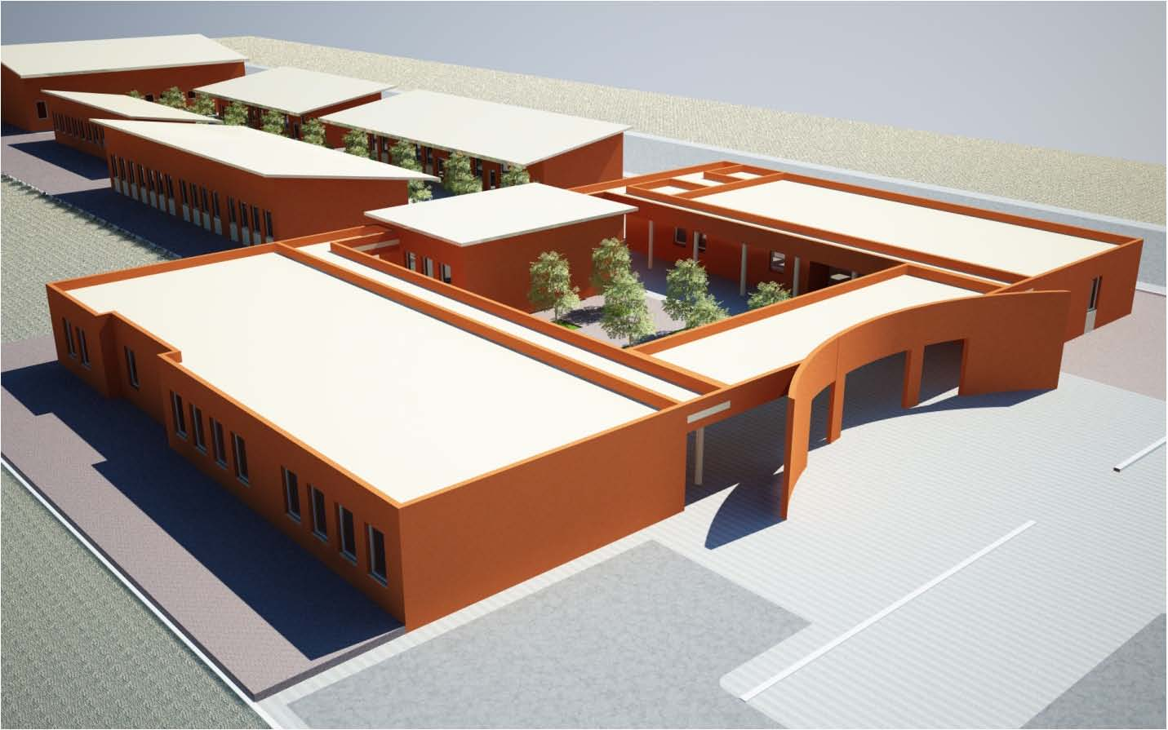

Slide 25
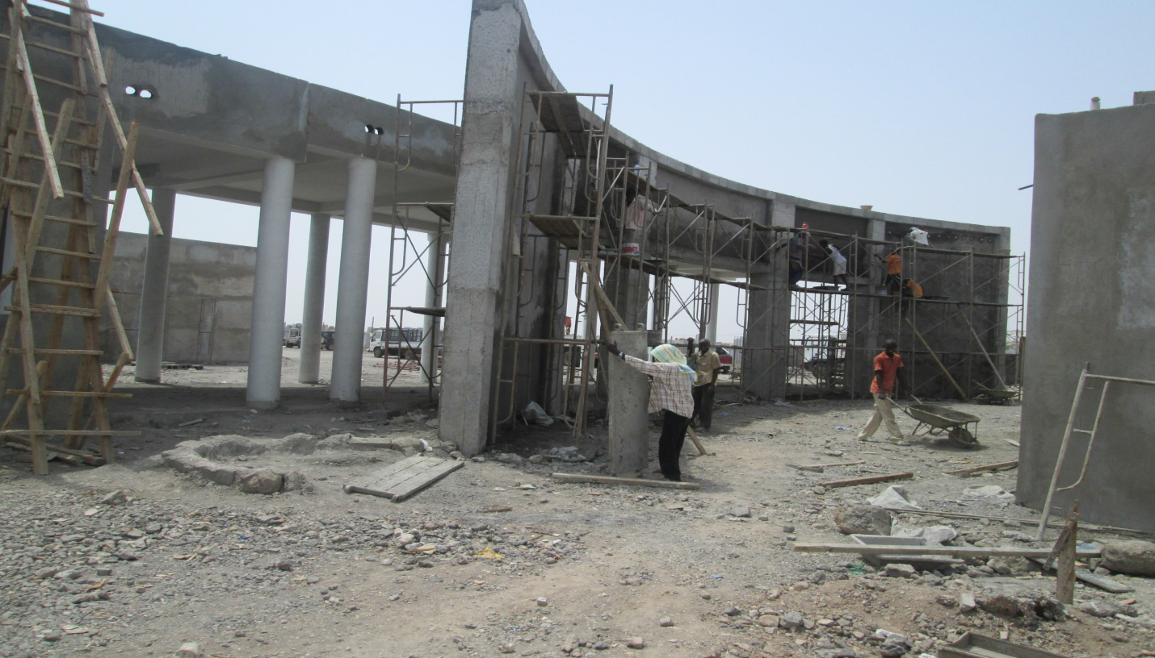

Slide 26
BASIC INFRASTRUCTURE IN 3 UNITS AT Balbala
LOT N°1 : Solid roads+water supply.
Roads :
  3215 m of roads dense of 6 m
  706 m of roads to renew solidly and enlarge of 6 m
Network of drinking water:
  7000 m of secondary networks
  6500 m of tertiary networks

Slide 27
LOT N°2 : Roads made out of cut stones and pavement
  622 m of roads coated with pavement and large of 8 m
  1185 m of roads coated with cut stones and large of 6 m
  2036 m roads coated with cut stones and large of 5 m

Slide 28
LOT N°3 : STREET LIGHTING AND NETWORKS BT + HT. (Implementation of works by EDD)
  230 m of MT airline
  4300 m of BT airline
  3 transformers
  public lighting (145 units)

Slide 29
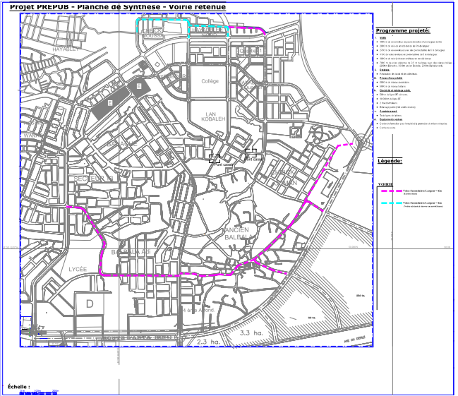
PROJECT EXECUTION : LOT1 ROAD IN DENSE COATING + WATER CONVEYANCE

Slide 30
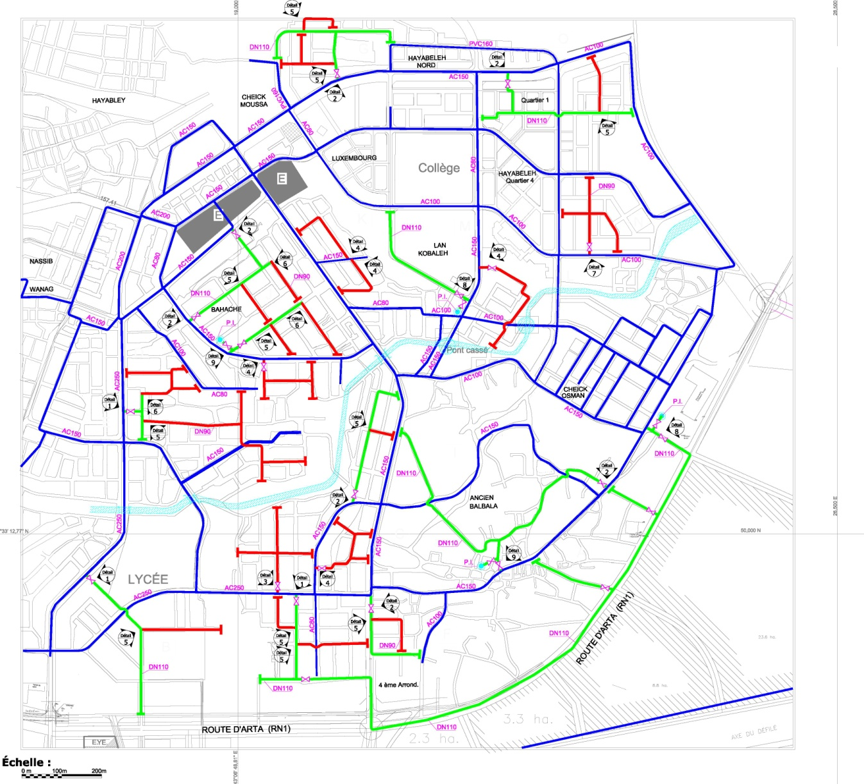
PROJECT EXECUTION : LOT1 ROAD IN DENSE COATING + WATER CONVEYANCE

Slide 31
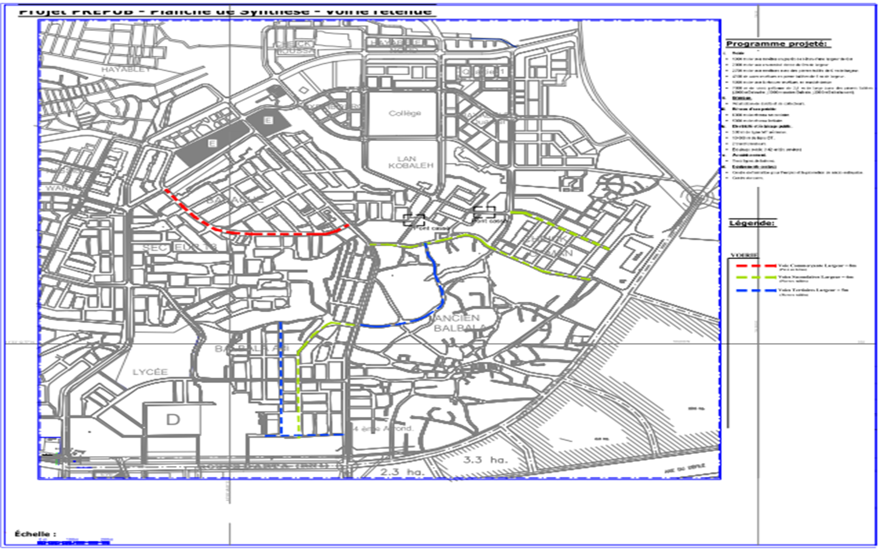
PROJECT EXECUTION : LOT2 ROAD IN CARVED STONE AND IN CONCRETE PAVEMENT

Slide 32
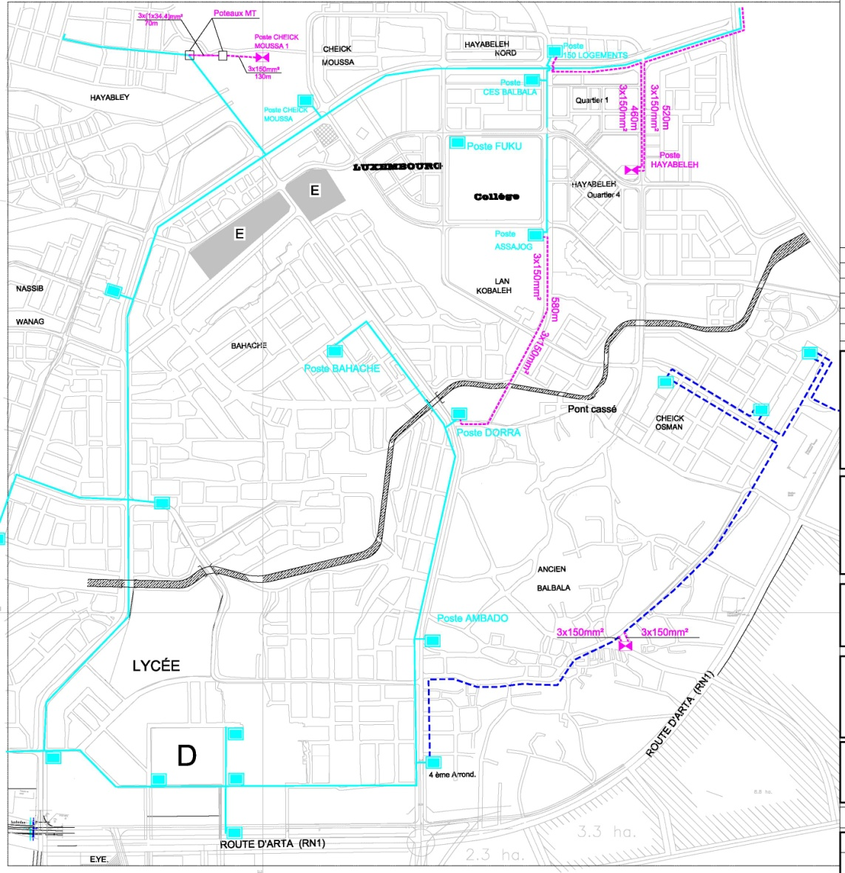
PROJECT EXECUTION : LOT3 PUBLIC LIGHTS AND BT+HT NETWORK
(Realization of works by the Djiboutian Electricity Department)

Slide 33

URBAN POVERTY REDUCTION PROGRAM IN QUARTIER 7

Slide 34
Funder | WORLD BANK (INTERNATIONAL DEVELOPMENT INSTITUTION)
Title | PREPUD IDA
Area of intervention | QUARTIER 7 of the Capital City
Number of Beneficiaries | Around 23 000 (ie, the entire population of Quartier 7)
Cost | 3 900 000 DTS , ie, around 5.800 000 USD (initial budget Donation H356DJ + additionnal Donation H582DJ)
COMPONENTS | ACTIVITIES | OBJECTIVES
INFRASTRUCTURE IMPROVEMENT | Renovation of boulevard 57 (lane for minibuses) with an asphalt surface | 557 Ml covered, ie, 4 260 m² (finalized, final receipt, after a one year warranty to be pronounced at the end of the month of december ).
 | Renovation of boulevard 50 by paving it with cut stone (new axis Nort-South). | 575 Ml covered, ie, 1 910 m² (finalized, pr ovisional receipt, pronounced in june 2014 ) : Notice: However, this type of pavement absorbs more than the asphalt, the pavement remains cleaner.
 | Renovation of the lanes 35 and 37 (new axis East-West) | 985 Ml covered, ie, 7 831 m² (road37 final receipt pronounced at the end of december , also road 35 is finished – provisional receipt is pronounced in August 2014.
 | Public lighting of the renovated lanes | Around 30 street lights ensure lighting at night for the additional lanes and the renovation of the low tension distribution network on lane 57 and 35 (finalized ) Extension of the transformation units (additional 400 KVA) finalized

Slide 35
COMPONENTS | ACTIVITIES | OBJECTIVES
INFRASTRUCTURE IMPROVEMENT | Renovation of rain water drainage works in the outskirts of Quartier 7 Cleaning out of the type E lane’s scupper-hole Purchase of a cleaning truck for the National Office for Water and Waste Manangement | Scupper-hole cleaned and functional from lane 57 to Arta Road. Truck must reach Djibouti at the end of the month of November
 | Showroom for WASH products | Diplay of the WASH products to the public
 | Construction of a Community Development Center in South Quartier 7. (Finished. An internet cafe was installed in one of the rooms of the Center) | Utilization of the R+1 Center (1000 people per year)
 | Construction of a Health Center (Omar Gouled Garden) | Building was received provisionally since August 2014. (water and electricity connection must be done)
 | Construction of mini garden for kids (Omar Gouled Garden) | ie, 560 m² arranged as playing ground for kids (planned end of works, november 2014)
 | Construction of sports and games grounds (football field, gaming-room, multi-sports grounds) -Construction of a building with two community halls, one booth and public toilets | ie, 2 sites arranged as green spaces and sport grounds of 2500 m² (final receipt in December 2014).

Slide 36
COMPONENTS | ACTIVITIES | OBJECTIVES
COMMUNITY DEVELOPMENT | Literacy and post literacy program | ie, about 1000 people are taught to read and write in french language (second session is finished)
 | Vocational training of the youth of Quartier 7 (heavy truck driving licences, mechanics-welding, cooking, sewing, security agent, bilingual receptionist, pastry-making, electrics | 200 to 300 youth trained at the end of the project (second session is finished)
 | Capacity reinforcement for the commune (training for the representatives and supply of IT hardware) | Autonomous commune (attained)
 | Capacity reinforcement for the NGO’s of Quartier 7 (training in project management) | 32 NGOs trained in project management (done, 2 sessions carried out in several fields)
 | Public Waste Management ( capacity reinforcement for the Roads Department in the fields of project coordination. These said projects are funded by the French Development agency, European Union, JICA, etc. The Roads Department was also supplied with a software for accounts and financial management-SAGE) | SERVER and the software SAGE are being installed. This should be done within december 2014. Logiciel Sage is being installed
 | Individual latrines (implementation of the short term activities of the Djiboutian Wash Strategic Planning in partnership with the UNICEF ) finalization of the study on the cost reduction of the latrines for the current project | 10% of the households are sensitized about the improved latrines.

Slide 37
COMPONENTS | ACTIVITIES | OBJECTIVES
TECHNICAL SUPPORT | Economical and social analysis of the intital conditions in Quartier 7 | Knowing the living conditions before the implementation of the PREPUD project (finalized)
 | Study on the socio-economical situation of the households of Quartier 7 and their willingness to pay for their own latrines | Find out the investment capacity of the households for their latrines
 | Environmental impact assessment | Reduce the negative impacts of the execution of the projetct (finalized)
 | Purchase of audio-visual equipment and support for showing the evolution of the project (photos ) (campagne photographique) | Communication and follow-up tools- evaluations are available and used
 | Drawing up communication tools (leaflet, image box of the latrines) | Information and awareness generating activities (finalized)
 | Mass communication (radio broadcast and televised documentary- 26 minutes of investigation) | Information and awareness generating activities
 | Supply and implementation of a computarized management system (tom@te) | A.D.D.S. has a management system that has been endorsed by the funders
 | Study on the lessons learned, analysis of the community development activities and satisfaction survey | Study finalized
 | Completion report for the PREPUD program | Terms of Reference for the consultant are being written at the moment
 | Training of the ADDS staff | Capacity reinforcement of the personnel (10 people) – (finalized))
 | Recruitment of a consultant / expert assessment (financial audit, projet coordination, etc) | Follow up and control of the PREPUD Q7 till the end of the project (31st december 2014+ 4 months as a grace period )
 | Drawing up an Urban Planning Program and updating the cartography or the capital (road axis, fragmentary mapping, etc.) | Manage and know the capital’s extension (Final workshop, 5th November 2014).

Slide 38
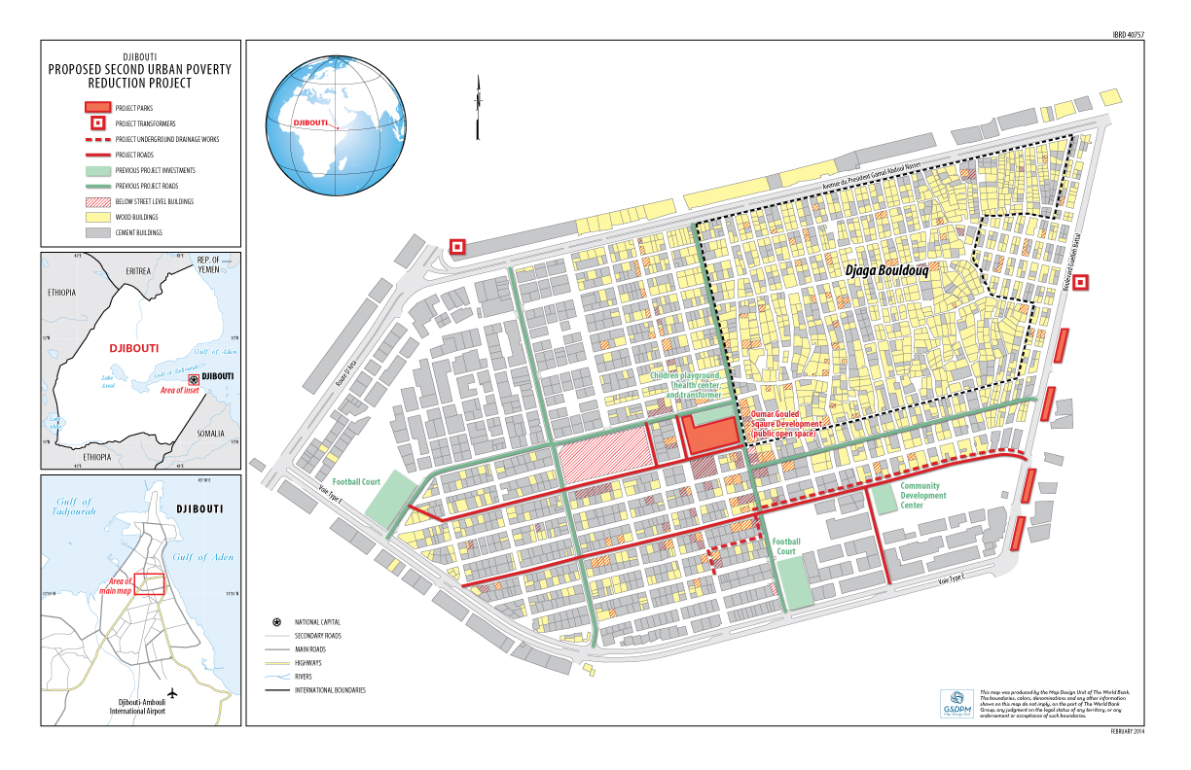

Slide 39
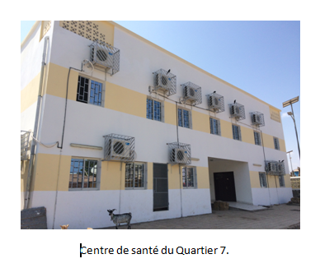
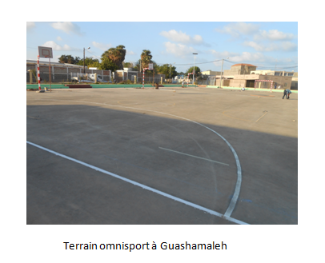
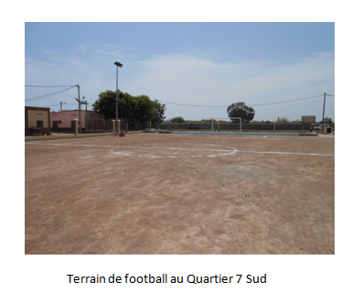
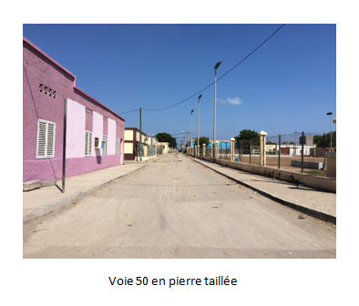

Slide 40
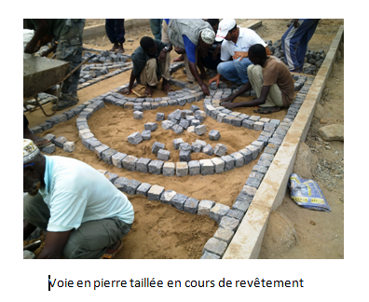
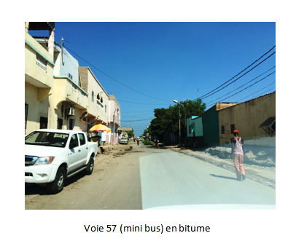
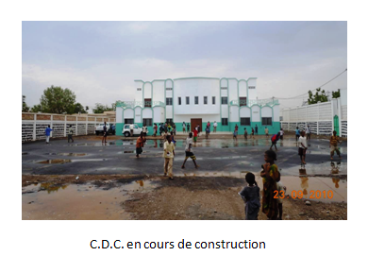
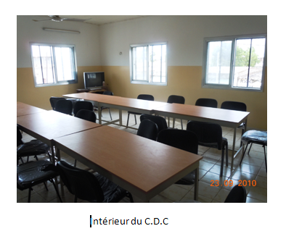

Slide 41
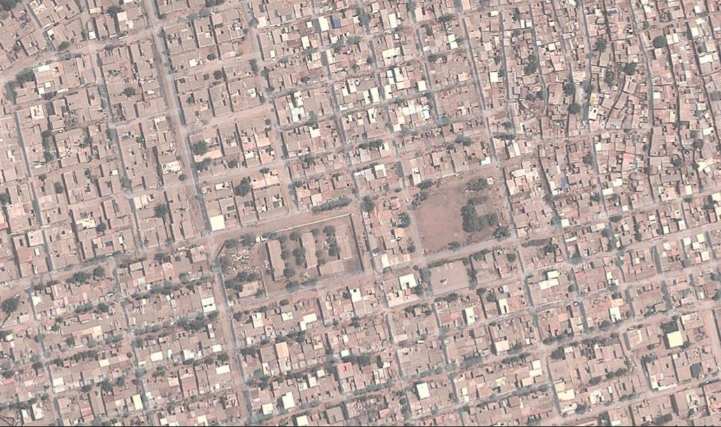
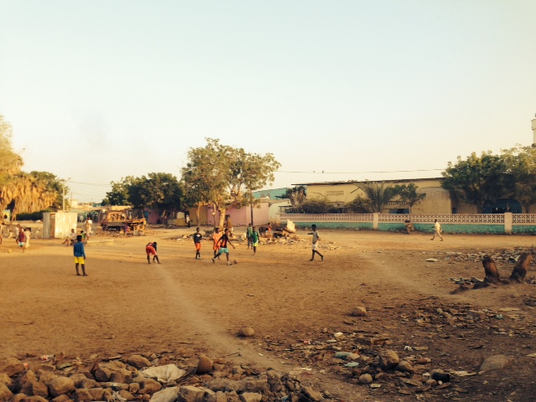
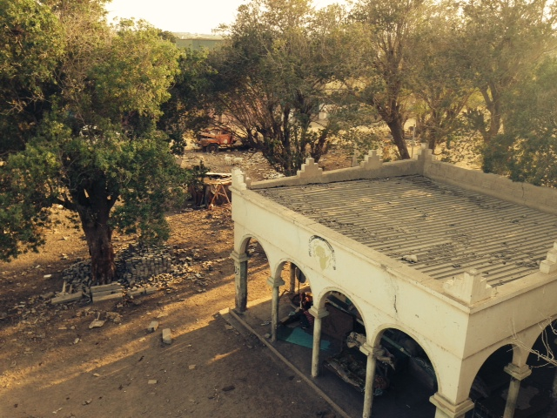
Omar Gouled square, to be converted (intervention of an international architect is under way).

Slide 42
SOCIAL DEVELOPMENT DEPARTMENT

Slide 43
MISSION
Awareness generating activities and mobilization of the population around the agency’s projects;
Capacity reinforcement for the partners in the local development efforts;
Vocational training for young drop-outs.

Slide 44
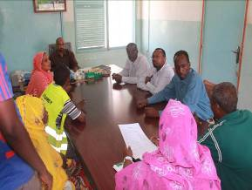
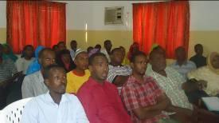
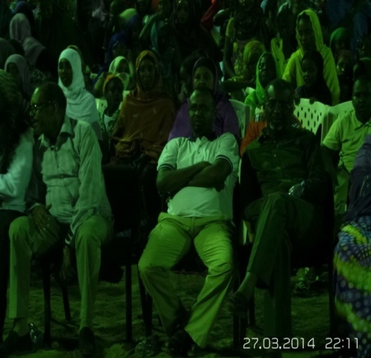
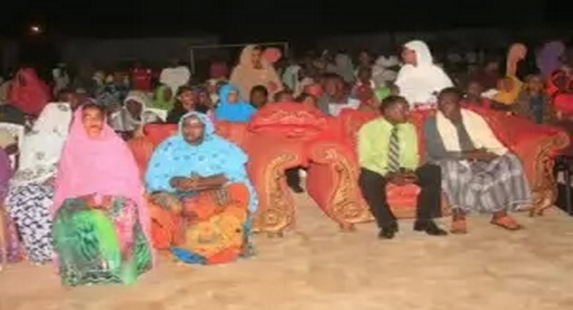
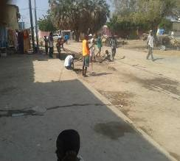
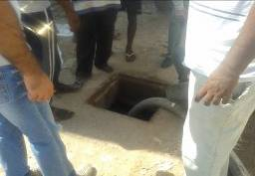
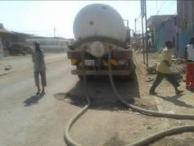
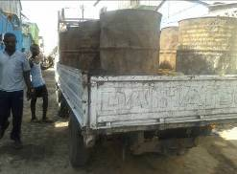
ACTIVITIES CARRIED OUT IN 2014
I – HOSTING AWARENESS RAISING ACTIVITIES
The beneficiaries are permanently kept informed about the progress of the projects through the agents of the ADDS on the field;
Information meetings with the local partners (regional councils, communes, prefectures, sub-prefectures, NGOs, neighbourhood committees, prominent citizens, youth…etc.);
Information and dialogue inducing meetings with the beneficiary committees for the safety net program in Balbala, Damerjog, Douda, Adailou, Dikhil and Obock.

Slide 45
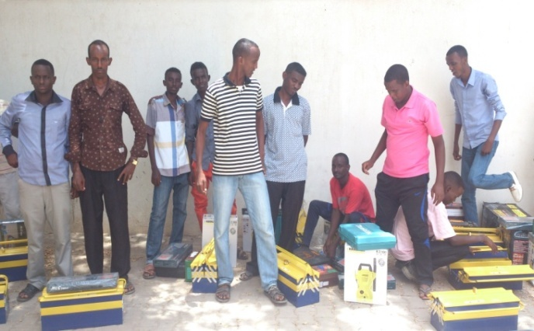
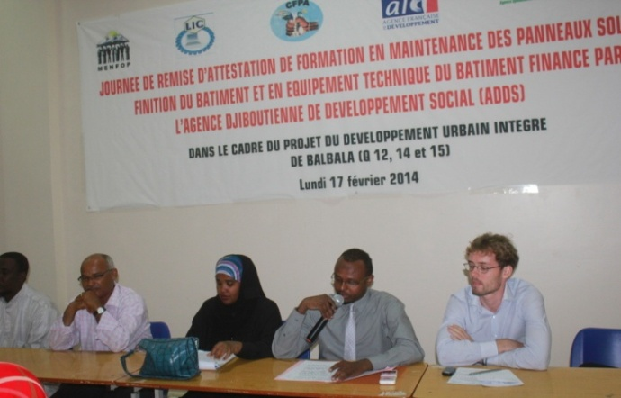
ACTIVITIES CARRIED OUT IN 2014 ON THE PDUI AFD BALBALA PROJECT
III – VOCATIONAL TRAINING
Stream | Number of beneficiaries | Training center | Funding
Tool kits given to young trainees | 30 | LIC (Secondary School for vocational training) | AFD
Driving licence training | 25 | Driving School | FSN
Follow up on heavy truck driving trainees | 90 | Driving School | FSN/AFD
Total | 145

Slide 46
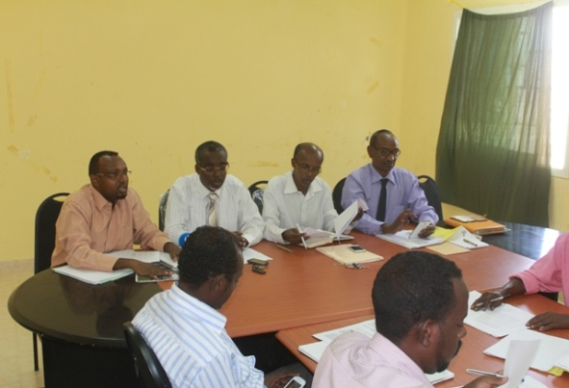
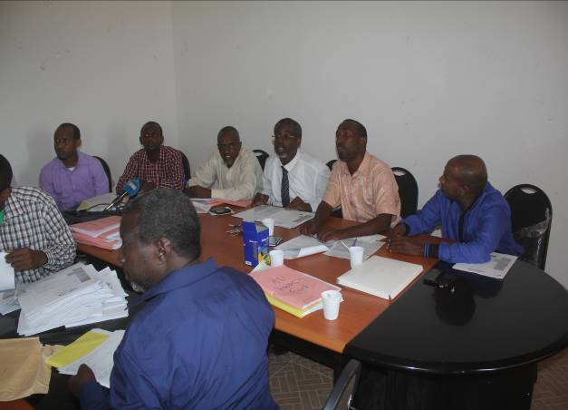
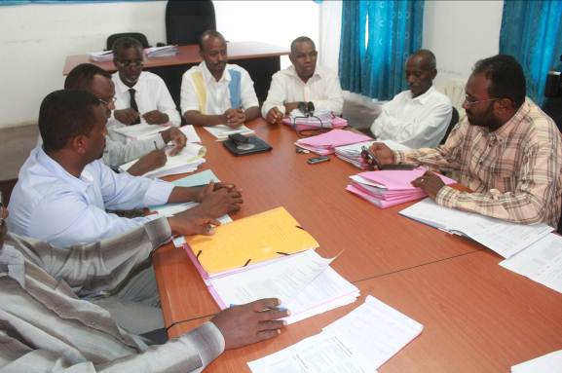
ACTIVITIES CARRIED OUT IN 2014 ON THE PREPUD BAD PROJECT
I – Analysis and validation sessions for community microprojects by the FDC committee
REGIONS | NUMBER OF SUBMITTED PROJECTS | NUMBER OF APPROVED PROJECTS | DATES FOR THE VALIDATION MEETINGS
ALI-SABIEH | 33 | 16 | 27th of May 2014 and 8th nov 2014
TADJOURAH | 46 | 19 | 14th May 2014 and 17th nov 2014
OBOCK | 13 | 4 | 7th June 2014
ARTA | 27 | 13 | 1st session the 10th May and 2nd session the 7th September 2014
DIKHIL | 22 | 7 | 23rd June 2014
TOTAL | 141 | 59

Slide 47
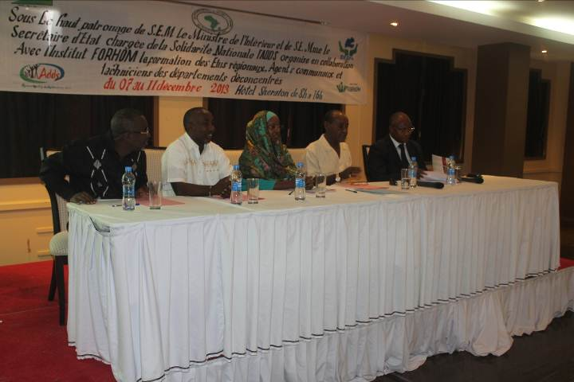

II. Capacity reinforcement for local authorities
Theme | Dates | Number of participants | Place
Collection and treatment of solid waste; | 7th January 2014 | 25 | Sheraton Hôtel, Djibouti
Contracting Authority’s Representative; | 18th to 22th January 2014 | 25 | Sheraton Hôtel, Djibouti
Rural and urban hydraulics; | 23rd to 27th february | 20 | Sheraton Hôtel Djibouti
Development projects and integration of the civil society | 15th to 19th february 2014 | 22 | Sheraton Hôtel Djibouti
Organization and functioning of local governments; | 18th to 22nd march 2014 | 29 | Sheraton Hôtel Djibouti
Total |  | 121

Slide 48
ACTIVITIES CARRIED OUT IN 2014 ON OTHER PROJECTS (PSAI, PRDL)
Project | Action | beneficiaries | Funding
Support to the Agricultural Cooperatives | Debt Collection from the sale of agricultral equipment kits made by the CPEC | 170 kits | FADES
Djibouti Loyada Road Project (PRDL) | Capacity reinforcement for Self-help affinity Groups | 25 groups created | BID
Occupationnal retraining for dockers | Follow up and supervision of the young trainees (transport, heavy trucks) | 34 dockers | Trust fund (Al Hamoudi),

Slide 49
SOCIAL SAFETY NET PROGRAM
Funding : Japanese Funds for Social Development and the World Bank
Montant : 8,6 millions $ (out of which 3.6 M by Japan and 5 millions by the WB)
Objectives :
    Creation of temporary jobs in the areas covered by the program.
    Prevention of child malnutrition.
    Rehabilitation and maintenance of rural infrastructure.
    Set up of works for community usage in the areas covered by the project.

Slide 50


AREAS COVERED BY THE PROGRAM
Composantes
Component 1:
Labor intensive work for the community
Component 2:
Community based malnutrition prevention

Slide 51




PICTURES OF LABOR INTENSIVE WORK AND SERVICES

Slide 52




PICTURES OF MALNUTRITION PREVENTION ACTIVITIES

Slide 53
STATE OF PROGRESS OF THE INTENSIVE LABOR SERVICES AND WORKS
AREA/ LOCALITY | NUMBER OF PAST BENEFICIARIES | NUMBER OF CURRENT BENEFICIARIES | TOTAL
MOUSTIQUAIRE | 1125 | 143 | 1368
Q5 | 612 | 147 | 760
HAYABLEH | 387 | 124 | 511
BÂCHE À EAU | - | - | -
ARHIBA | - | - | -
ADAILOU | 688 | 56 | 744
DAMERJOG-ATAR | 855 | 129 | 984
DOUDA | 99 | 0 | 99
OBOCK | 599 | 252 | 851
DIKHIL | 745 | 227 | 972
TOTAL | 5110 | 1078 | 6289

Slide 54
STATE OF PROGRESS FOR NUTRITION ACTIVITIES
NUTRITION COMPONENT
SITES | NB OF PLANNED BENEFICIARIES | NB OF ACTUAL/CUMULATED BENEFICIARIES | NB OF PREGNANT WOMEN | NB OF BREASTFEEDING WOMEN | NB OF CENTERS FOR PREGNANT WOMEN CREATED | NB OF CENTERS FOR CHILDREN CREATED
MOUSTIQUAIRE | 784 | 1241 | 331 | 910 | 22 | 54
Q5 | 672 | 719 | 165 | 554 | 12 | 36
HAYABLEY | 1488 | 1278 | 255 | 1023 | 25 | 76
ATAR/DAMERJOG | 256 | 390 | 128 | 262 | 7 | 15
DOUDA | 145 | 104 | 31 | 109 | 3 | 7
ADAILOU | 209 | 360 | 76 | 284 | 9 | 19
DIKHIL | 800 | 707 | 87 | 620 | 7 | 32
OBOCK | 695 | 777 | 52 | 729 | 8 | 4
Total | 5049 | 5576 | 1125 | 4491 | 93 | 243

Slide 55
OUTLOOK 2015
I – SOCIAL AWARENESS ACTIVITIES
Continuation of the awareness generating activities for the population living in the areas targeted by the agency’s projects;
Continuation of the dialogue with the local partners so as to answer better to their needs.

Slide 56
Four New Projects in 2015
I. Emergency Help to the Yemeni refugees
Funding: African Development Bank
Budget: 1 Million USD
The outbreak of the political crisis in Yemen in Mars 2015 caused a massive influx of refugees on Djiboutian soil.

Slide 57
II. Support for the realization of economic infrastructures and promotion of economic activities for the country’s interior regions
Funding: African Development Bank
Budget: 11 Million USD
The general objective of this project is to improve the living conditions of the inhabitants of the interior regions, to promote inclusion and equality between the sexes.

Slide 58
III. Reforming the management of the refugee displacements in Djibouti
Funding: World Bank
Budget: 15 Million USD
Displaced people apply a strong pressure on host populations and their ressources. The main objectives of the project are:
Improve the refugees’ access to social services
Extend economic opportunities
Improve the environment management capacities of host communities and displaced people in target areas of Djibouti
The project will deal with the needs of host communities around the refugee camps of Ali-Addeh, Hol-Holl and Balbala.

Slide 59
IV. Employment and handicraft promotion for the Youth
Funding: World Bank, Japan Self-Defense Forces
Budget: 2.7 Million USD
The objective of the project is to improve:
-The access to practical skills by training
-The access to business financing for 3000 youth and women with little or no qualifications. The target beneficiairies will be selected from the areas of Djibouti-city, Arta, Tadjourah and Ali-Sabieh.

Slide 60
MICRO FINANCE DEPARTMENT

Slide 61
AREA OF INTERVENTION
  Urban area
    Djibouti city with one main paydesk and 4 service points
  Suburban areas
    In Balbala : 1 Micro finance pilot unit
  Rural Area (2 paydesks et 2 service points)
    Tadjourah
    Obock
    Ali sabieh
    Dikhil

Slide 62
TARGET GROUP AND BENEFICIARIES
  Butchers
  Fishermen
  Agriculturers
  Livestock farmers
  Unemployed youth, drop outs, and graduates
  Women
  Wage earners
  Retired
  Informal sector
  Micro entreprises
  GROUPE

Slide 63
III –FINANCIAL REALIZATIONS
GOVERNMENT
  Operating Subsidy to the CPEC of Djibouti, to the regional CPECs and to the Islamic Microfinance Unit
UNDP
  Credit line for the youth ➔ 300 thousand dollars USD
ABD
  Capacity reinforcement➔ Technical support to the MFI, to the CBD and to the management of the MFD
BID
  Credit line ➔ 1 million dollars, as support for the Islamic Microfinance pilot unit

Slide 64
RURAL ELECTRIFICATION UNIT

Slide 65
ACTIVITIES CARRIED OUT, IN PROGRESS AND FUTURE WITHIN THE RURAL ELECTRIFICATION UNIT
Funders | Project | Amount (million Fdj) | Status | Realizations/Beneficiaries
Government | Solar Kit Holl Holl PK 12 Hayableh/Layableh | 357 | Finished | 603 households (4.200 households)
Government/KOICA | Solar power plant | 219 | Functionnal | -23 households and shops 5 public buildings (schools, health centers, army, mosque, public building)
Government | Solar Street lights | 728 | Installed | Djibouti city (550) Regions (200)
Government | Water conveyance Yoboki | 70 | Nearing completion | Population of Yoboki (4.000 personnes)
Total |  | 1 304
Government/other funders | Solar power plant (As Eyla, Yoboki, Randa, Adailou) | Currently being calculated | In prospects (studies in progress) | The rural population and public buildings

Slide 66


PICTURES OF REALIZATIONS

